Slide 1
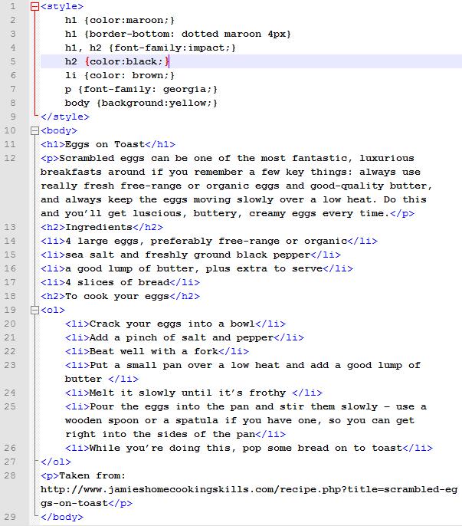
HTML Coding

Slide 2
Webpage structure
HTML Tags
<style>
.
.
</style>
<body>
.
.
.
</body>
<h1>
<h2>
<p>
<ol>
<li>

Slide 3
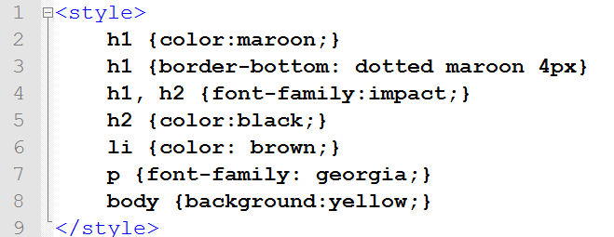

Style structure
stylesheet
EXAMPLES
h2 {text-align:center;}
h1 {font-size:20px;}
p {font-family: “Arial”;}
h2 {border-top: dotted red 6px;}
body {background: black;}
STYLES
selector {property:value;}
E.g.
h1 {background:black;}
You can also do more than one selector at once:
h1, h2 {font-family: “Impact”;}
American spelling
Look at: http://www.w3schools.com/cssref/css_colornames.asp for colors

Slide 4
Images in webpages
Code for a picture
<img src = “my_picture_file.png” />
In this example, the picture is in the same folder as the webpage file. So you must save it from the internet first, draw one yourself in something like Paint or Photoshop, or take one yourself with a digital camera.
The picture can be a .gif, .png, or .jpg file.

Slide 5
Webpage Task
Make a webpage about your favourite film, TV programme or band.
It must include a heading, subheadings, some writing about your favourite thing, a list of facts (eg characters, songs) that are in paragraphs, and at least one picture.
Lists can be used where appropriate. E.g. track names on an album.

